Slide 1


A Hybrid Document Understanding System Using Vision and Language Transformers
Department of Information Technology
V R Siddhartha Engineering College
B.Tech in Information Technology
MAJOR Project Review Presentation
Presented by
Ms . Poojitha Gatta (228W1A1287)
Mr. Jaya Naga Vardhan Lukka (228W1A12A4)
Batch - 19
Under the guidance of
Dr. M. Suneetha, Head of the Department

Slide 2
AGENDA
Introduction and Problem Statement
Objectives and Outcomes of the Project
Literature Survey and Summary
Datasets and Requirements specifications
Algorithms used in the Project
Architecture diagram
Implementation steps and Execution
Results obtained
Results Analysis
Conclusion &Future Work
References

Slide 3
INTRODUCTION
• The rapid growth of multi-page digital documents has made manual document processing inefficient and time-consuming, creating the need for automated systems capable of intelligent document understanding.
• Traditional approaches fail to handle complex layouts, cross-page dependencies, and interleaved image-text content, resulting in loss of structural and contextual information.
• To overcome these challenges, our system integrates a Vision Transformer (DiT) for layout-aware feature extraction and FAISS-based semantic retrieval to improve document classification accuracy and efficiency.
• For long-document summarization, we employ long-context language models (LED/BART) along with optimization strategies to maintain coherence, preserve key information, and handle large contextual dependencies effectively.

Slide 4
PROBLEM STATEMENT
The exponential growth of digital documents across industries has created challenges in organizing, retrieving, and understanding information efficiently. Manual processing is slow, and not feasible at scale.
Many existing approaches rely only on textual features and ignore layout and visual structure, which reduces accuracy when dealing with complex document formats.
Long-form documents contain complex structures and context spread across multiple sections, making it difficult for conventional models to generate coherent and information-rich summaries.
To generate accurate summaries, we identify the most important and non-redundant information from long documents by analyzing relationships between different sections and ensuring that the final summary reflects the overall consensus of the document content.

Slide 5
OBJECTIVES
To build a system that can correctly classify different types of documents by understanding their visual layout and content.
To create a summarization model that can read long documents and pick the most important information to generate a short and clear summary.
OUTCOMES
A document classification system that can accurately predict the document type, even for complex layouts.
A summarization system that produces short, meaningful, and non-redundant summaries from long documents.

Slide 6
LITERATURE REVIEW
Publication Details | Description | Models Used | Dataset | Result | Limitation
Year: 2026 Title: Coordinate Matrix Machine: A Human-level Concept Learning to Classify Very Similar Documents | Proposes a structure-aware document classification model that uses spatial coordinates of keywords instead of only text. | Coordinate Matrix Machine (CM2), Manhattan Distance-based similarity | 475 bank statements from 5 banks, 53 templates | Achieves up to 100% accuracy with optimal maximum penalty; outperforms CNN, LSTM, SVM, and traditional vectorizers. | Focused mainly on structured documents; may not generalize to highly unstructured text documents.
Year: 2025 Title: M-DocSum: Do LVLMs Genuinely Comprehend Interleaved Image-Text in Document Summarization? | Introduces a multimodal benchmark for long-document summarization with interleaved image-text reasoning. | GPT-4o, Gemini Pro, Claude-3.5-Sonnet, Qwen2.5-VL, M-DocSum-7B | M-DocSum-Bench (500 arXiv multimodal papers) | M-DocSum-7B achieves strong summarization performance compared to other open-source models. | Focuses on multimodal summarization; does not address document classification.

Slide 7
LITERATURE REVIEW
Publication Details | Description | Models Used | Dataset | Result | Limitation
Year: 2025 Title: DocRefine: An Intelligent Framework for Scientific Document Understanding and Content Optimization | Proposes a multi-agent LVLM framework for PDF understanding, content refinement, and automated summarization. | GPT-4o (LVLM-based multi-agent system) | DocEditBench | Achieves 86.7% Semantic Consistency, 93.9% Layout Fidelity, 85.0% Instruction Adherence. | Focuses on document editing and refinement rather than classification.
Year: 2025 Title: DocETL: Agentic Query Rewriting and Evaluation for Complex Document Processing | Introduces an LLM-based pipeline for structured document processing using agent-based query optimization. | LLM-driven agent framework | Police Records Dataset, Legal Contract Dataset | Shows improved accuracy via pipeline optimization and structured rewriting. | Focused on query rewriting and structured processing, not summarization or classification.

Slide 8
LITERATURE REVIEW
Recent research (2025–2026) highlights the growing use of LLMs and LVLMs in document understanding, with multi-agent and multimodal frameworks improving automation and reasoning.
Approaches are evolving from text-only methods to incorporating structure and layout, as well as interleaved image-text information for better processing of complex documents.
Significant performance gains are observed, including high semantic consistency, layout fidelity, and even near-perfect accuracy in structured document classification tasks.
However, most methods remain task-specific, focusing on areas like summarization, query rewriting, or structured classification, with limited ability to generalize across all document types.

Slide 9
DATASETS
Document Classification – RVL-CDIP dataset
https://www.kaggle.com/datasets/abdellatifsassioui/rvlcdip
Total samples used: 2997 document images (nearly 600 images for each class)
Total Labels: 5 document types
Labels: Advertisement, Invoice, Scientific Publication, News Article, Resume
Document Summarisation - arxiv-summarization
https://huggingface.co/datasets/ccdv/arxiv-summarization
It contains research papers collected from arXiv.
Each sample includes two parts:
Article – containing multiple sections and detailed explanations.
Abstract – a concise summary representing the key ideas of the document.

Slide 10
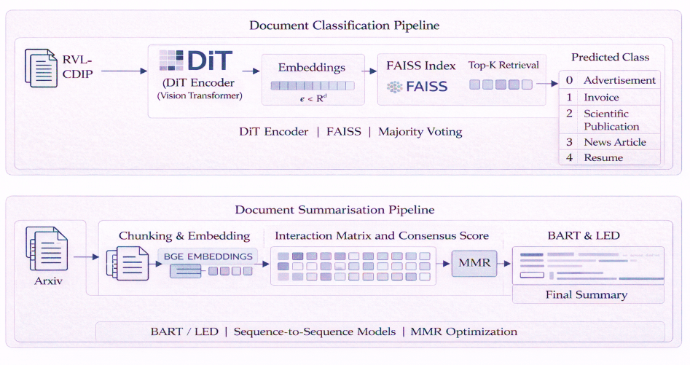
ARCHITECTURE DIAGRAM

Slide 11
ALGORITHM - llama-3.3-70b-verstaile
Algorithm: llama-3.3-70b-verstaile
Input: source code file
Output: Corrected code + Debugging Report + Test Cases.
Step 1: Prompt Construction (LangChain)
The given code snippet is inserted into predefined prompt templates.
Example template:
You are an expert software developer with experience in C, C++, Python, and Java. Identify bugs in the given code and explain them.
Prompts guide the LLM (LLaMA-3.3-70B) to focus on specific debugging tasks instead of producing random text.
Step 2: Tokenization (Input Preparation)
LangChain passes the constructed prompt to the LLaMA tokenizer.
The tokenizer converts text into tokens (numerical IDs).
These tokens are embedded into vector representations by the model’s embedding layer.
Step 3: Model Processing (Inside LLaMA-3.3-70B)
The embeddings are processed through ~80 Transformer decoder layers:

Slide 12
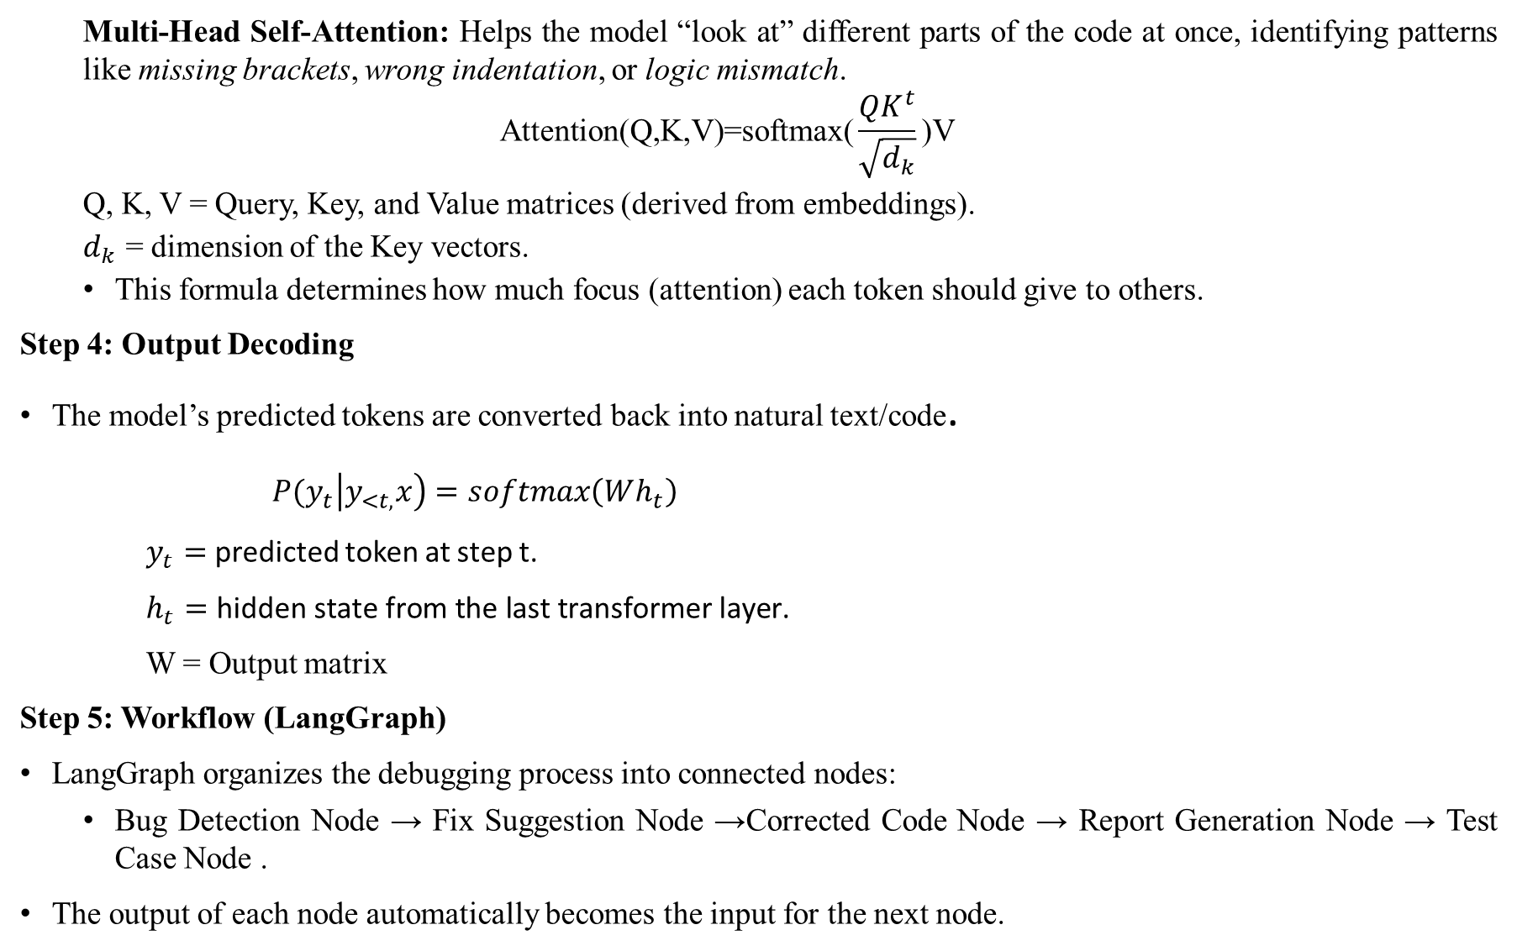
Multi-Head Self-Attention: Helps the model “look at” different parts of the code at once, identifying patterns like missing brackets, wrong indentation, or logic mismatch.
$$\text{Attention}\text{(}\text{Q}\text{,}\text{K}\text{,}\text{V}\text{)=}\text{softmax}\text{(}\frac{{QK}^{t}}{\sqrt{d_{k}}}\text{​)}\text{V}$$
Q, K, V = Query, Key, and Value matrices (derived from embeddings).
$d_{k}$​ = dimension of the Key vectors.
This formula determines how much focus (attention) each token should give to others.
Step 4: Output Decoding
The model’s predicted tokens are converted back into natural text/code.
$P{(y}_{t}\left|y_{<t,}x\right)=softmax\left(Wh_{t}\right)$
$y_{t}=$ predicted token at step t.
$h_{t}=\text{hidden} \text{state} \text{from} \text{the} \text{last} \text{transformer} \text{layer}\text{.}$
W = Output matrix
Step 5: Workflow (LangGraph)
LangGraph organizes the debugging process into connected nodes:
Bug Detection Node → Fix Suggestion Node →Corrected Code Node → Report Generation Node → Test Case Node .
The output of each node automatically becomes the input for the next node.

Slide 13
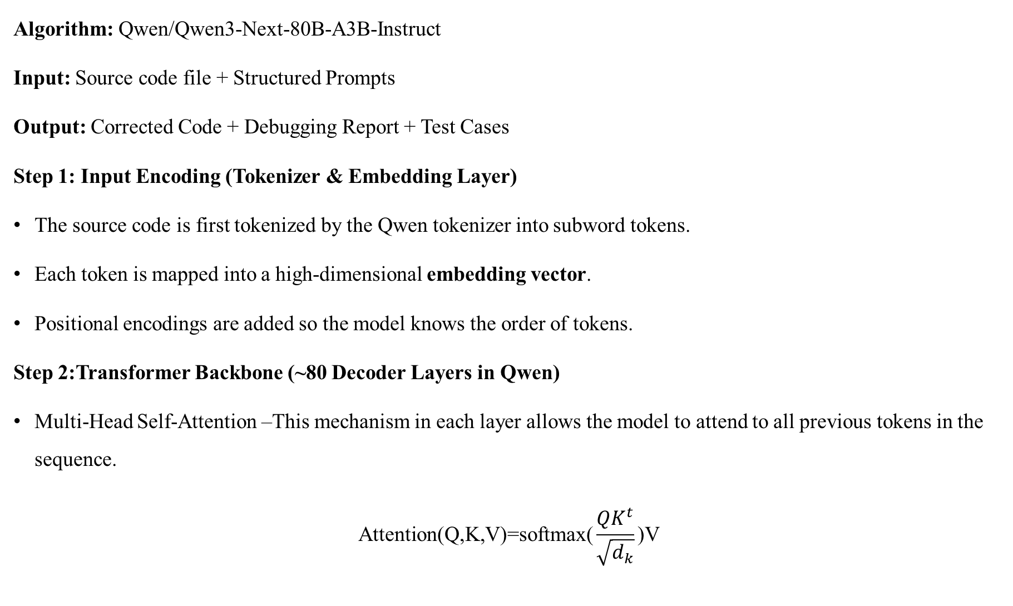
ALGORITHM – Qwen/Qwen3-Next-80B-A3B-Instruct
Algorithm: Qwen/Qwen3-Next-80B-A3B-Instruct
Input: Source code file + Structured Prompts
Output: Corrected Code + Debugging Report + Test Cases
Step 1: Input Encoding (Tokenizer & Embedding Layer)
The source code is first tokenized by the Qwen tokenizer into subword tokens.
Each token is mapped into a high-dimensional embedding vector.
Positional encodings are added so the model knows the order of tokens.
Step 2:Transformer Backbone (~80 Decoder Layers in Qwen)
Multi-Head Self-Attention –This mechanism in each layer allows the model to attend to all previous tokens in the sequence.
$$\text{Attention}\text{(}\text{Q}\text{,}\text{K}\text{,}\text{V}\text{)=}\text{softmax}\text{(}\frac{{QK}^{t}}{\sqrt{d_{k}}}\text{​)}\text{V}$$

Slide 14
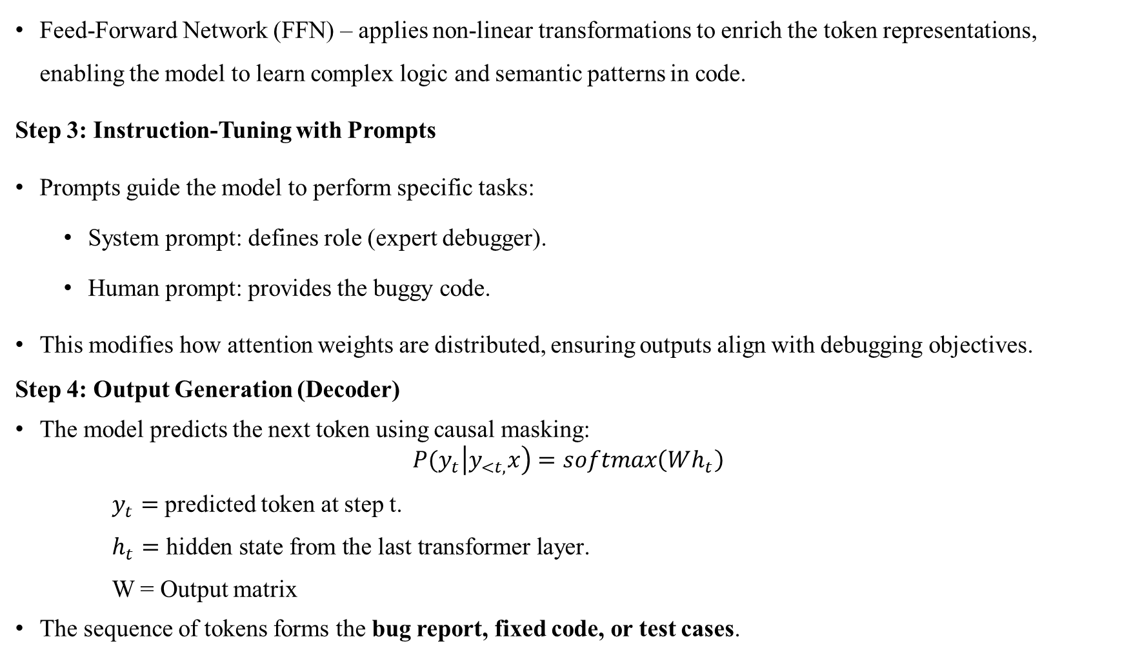
Feed-Forward Network (FFN) – applies non-linear transformations to enrich the token representations, enabling the model to learn complex logic and semantic patterns in code.
Step 3: Instruction-Tuning with Prompts
Prompts guide the model to perform specific tasks:
System prompt: defines role (expert debugger).
Human prompt: provides the buggy code.
This modifies how attention weights are distributed, ensuring outputs align with debugging objectives.
Step 4: Output Generation (Decoder)
The model predicts the next token using causal masking:
$$P{(y}_{t}\left|y_{<t,}x\right)=softmax\left(Wh_{t}\right)$$
$y_{t}=$ predicted token at step t.
$h_{t}=\text{hidden} \text{state} \text{from} \text{the} \text{last} \text{transformer} \text{layer}\text{.}$
W = Output matrix
The sequence of tokens forms the bug report, fixed code, or test cases.

Slide 15
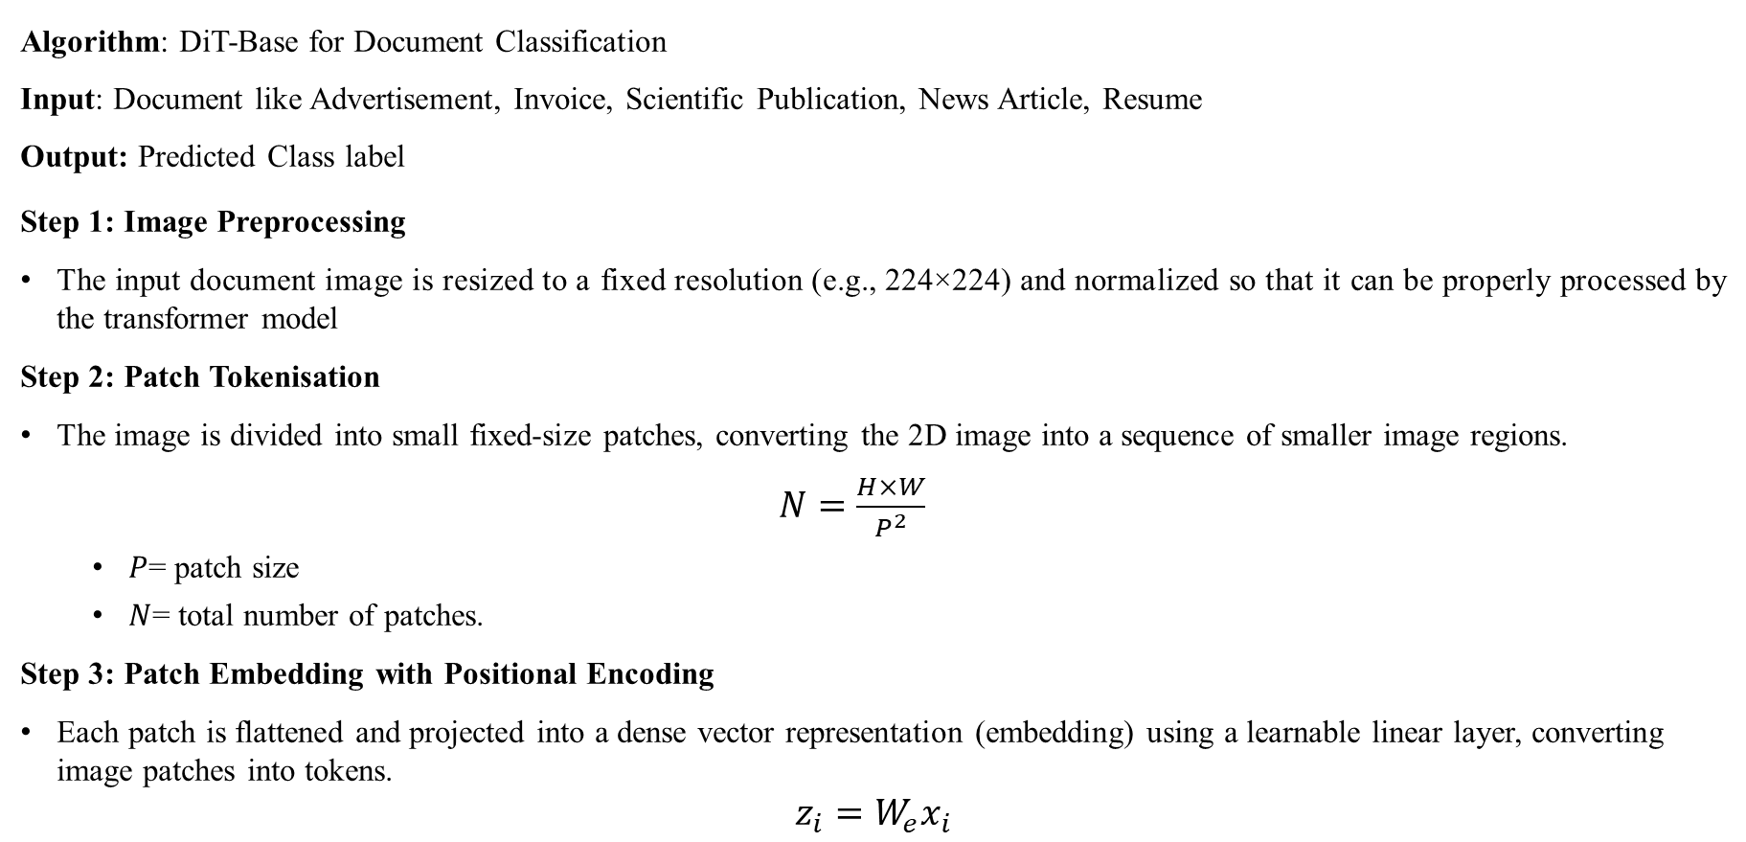
ALGORITHM - Document Image Transformer(DiT)
Algorithm: DiT-Base for Document Classification
Input: Document like Advertisement, Invoice, Scientific Publication, News Article, Resume
Output: Predicted Class label
Step 1: Image Preprocessing
The input document image is resized to a fixed resolution (e.g., 224×224) and normalized so that it can be properly processed by the transformer model
Step 2: Patch Tokenisation
The image is divided into small fixed-size patches, converting the 2D image into a sequence of smaller image regions.
$N=\frac{H×W}{P^{2}}$
$P$= patch size
$N$= total number of patches.
Step 3: Patch Embedding with Positional Encoding
Each patch is flattened and projected into a dense vector representation (embedding) using a learnable linear layer, converting image patches into tokens.
$$z_{i}=W_{e}x_{i}$$

Slide 16
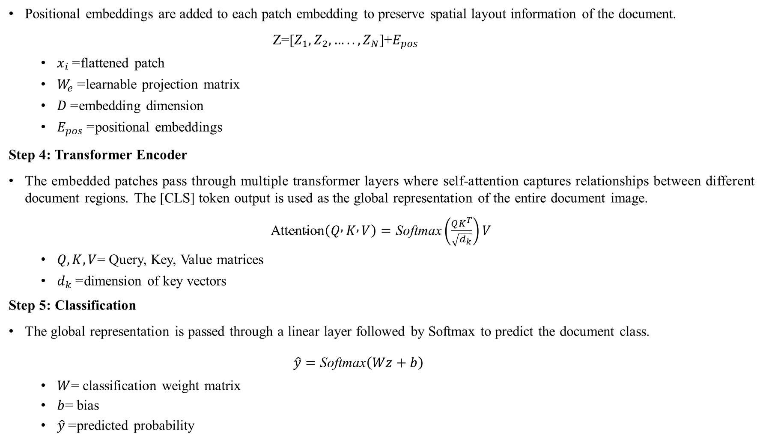
Positional embeddings are added to each patch embedding to preserve spatial layout information of the document.
Z=[$Z_{1},Z_{2},…..,Z_{N}$​]+$E_{pos}$
$x_{i}$= flattened patch
$W_{e}$= learnable projection matrix
$D$= embedding dimension
$E_{pos}$= positional embeddings
Step 4: Transformer Encoder
The embedded patches pass through multiple transformer layers where self-attention captures relationships between different document regions. The [CLS] token output is used as the global representation of the entire document image.
$\text{Attention}\left(Q , K , V\right)=\text{Softmax}\left(\frac{QK^{T}}{\sqrt{d_{k}}}\right)V$
$Q,K,V$= Query, Key, Value matrices
$d_{k}$= dimension of key vectors
Step 5: Classification
The global representation is passed through a linear layer followed by Softmax to predict the document class.
$\hat{y}=\text{Softmax}\left(Wz+b\right)$
$W$= classification weight matrix
$b$= bias
$\hat{y}$= predicted probability

Slide 17
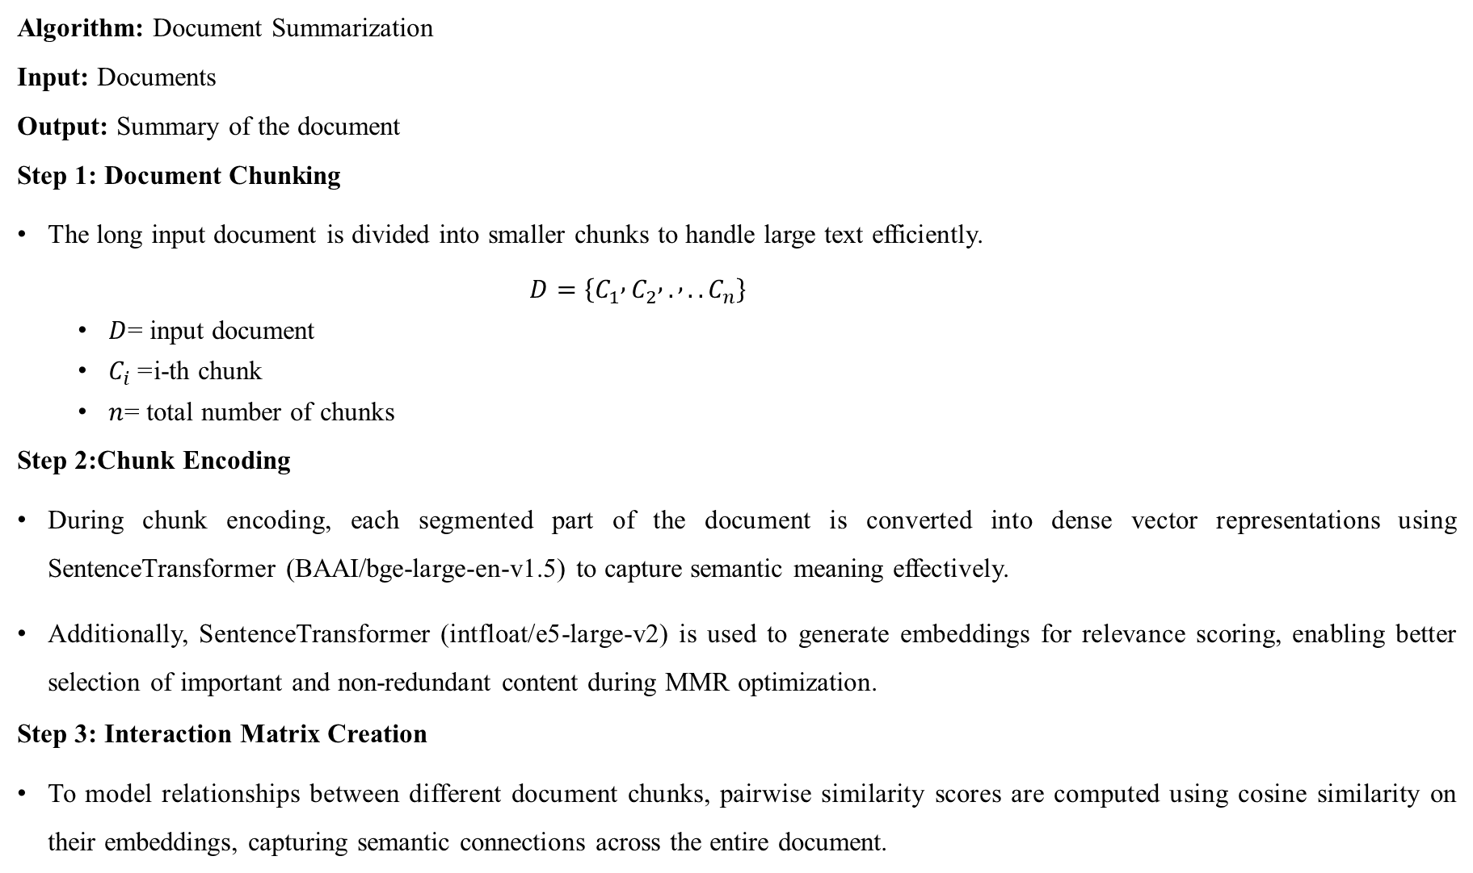
ALGORITHM – BART and LED
Algorithm: Document Summarization
Input: Documents
Output: Summary of the document
Step 1: Document Chunking
The long input document is divided into smaller chunks to handle large text efficiently.
$D=\left\{C_{1} , C_{2} , . , ..C_{n}\right\}$
$D$= input document
$C_{i}$= i-th chunk
$n$= total number of chunks
Step 2:Chunk Encoding
During chunk encoding, each segmented part of the document is converted into dense vector representations using SentenceTransformer (BAAI/bge-large-en-v1.5) to capture semantic meaning effectively.
Additionally, SentenceTransformer (intfloat/e5-large-v2) is used to generate embeddings for relevance scoring, enabling better selection of important and non-redundant content during MMR optimization.
Step 3: Interaction Matrix Creation
To model relationships between different document chunks, pairwise similarity scores are computed using cosine similarity on their embeddings, capturing semantic connections across the entire document.

Slide 18
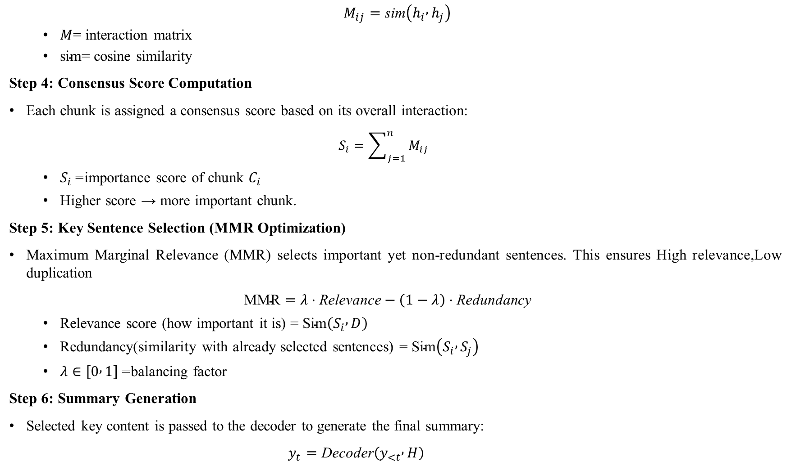
$M_{ij}=\text{sim}\left(h_{i} , h_{j}\right)$
$M$= interaction matrix
$\text{sim}$= cosine similarity
Step 4: Consensus Score Computation
Each chunk is assigned a consensus score based on its overall interaction:
$S_{i}=\sum_{j=1}^{n}{M_{ij}}$
$S_{i}$= importance score of chunk $C_{i}$
Higher score → more important chunk.
Step 5: Key Sentence Selection (MMR Optimization)
Maximum Marginal Relevance (MMR) selects important yet non-redundant sentences. This ensures High relevance,Low duplication
$\text{MMR}=λ⋅\text{Relevance}−\left(1−λ\right)⋅\text{Redundancy}$
Relevance score (how important it is) = $\text{Sim}\left(S_{i} , D\right)$
Redundancy(similarity with already selected sentences) = $\text{Sim}\left(S_{i} , S_{j}\right)$
$λ∈\left[0 , 1\right]$= balancing factor
Step 6: Summary Generation
Selected key content is passed to the decoder to generate the final summary:
$y_{t}=\text{Decoder}\left(y_{<t} , H\right)$

Slide 19
Implementation and Execution Steps
Document Classification
Input Dataset:The RVL-CDIP dataset is used as input, which contains diverse document images across multiple classes such as Advertisement, Invoice, Scientific Publication, News Article, and Resume.
DiT Encoder (Vision Transformer): Each document image is passed through the DiT (Document Image Transformer), which is a Vision Transformer designed to capture both visual and layout-based features. It divides the image into patches and uses self-attention to understand spatial relationships between different regions of the document.
Feature Embeddings: The DiT encoder converts each document into a high-dimensional embedding vector that represents both its textual appearance and structural layout. These embeddings serve as compact and meaningful representations of the documents.
FAISS Indexing & Retrieval: All document embeddings are stored in a FAISS index for efficient similarity search. During inference, the query document embedding is compared with stored embeddings, and Top-K similar documents are retrieved based on distance metrics.
Majority Voting / Prediction: The retrieved Top-K similar documents are analyzed, and a majority voting mechanism is applied to determine the final predicted class.

Slide 20
Implementation and Execution Steps
Document Summarization
Input Dataset: The arXiv summarization dataset is used, where each sample contains a long research article and its corresponding abstract. These long-form documents require special handling due to their size and complexity.
Chunking & Embedding: Documents are divided into smaller chunks for efficient processing, and embeddings are generated using bge embeddings for semantic understanding and e5 embeddings for MMR-based relevance scoring.
Interaction Matrix & Consensus Score: An interaction matrix is computed using similarity measures (e.g., cosine similarity) between all chunks. Based on this, a consensus score is assigned to each chunk, identifying the most important and representative parts of the document.
MMR Optimization: Maximum Marginal Relevance (MMR) is applied to select key content by balancing relevance and redundancy. This ensures that the selected information is both important and diverse, avoiding repeated or overlapping content in the summary.
BART / LED Model: The selected key content is passed into sequence-to-sequence models such as BART or LED. These models generate coherent and context-aware summaries while maintaining logical flow and preserving essential information.

Slide 21
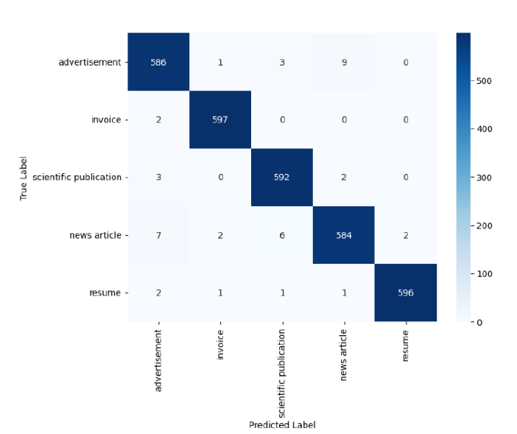
RESULTS OBTAINED
Document Class | Precision | Recall F1-score
Advertisement | 0.98 | 0.98 0.98
Invoice | 0.99 | 1.00 0.99
Scientific Publication | 0.98 | 0.99 0.99
News Article | 0.98 | 0.97 0.98
Resume | 1.00 | 0.99 0.99
Overall Accuracy |  | 0.99
Table 1: Evaluation Metrics for Document Classification
Fig. 1: Confusion Matrix

Slide 22
RESULTS OBTAINED
The LED model outperforms BART across most metrics, achieving higher Semantic Accuracy (0.8517), Semantic Consistency (0.6201), and Layout Fidelity (0.9380), indicating better understanding of long and structured documents.
However, BART achieves a lower redundancy score (0.3683) compared to LED (0.3933), meaning it produces slightly less repetitive summaries.
Metric | BART | LED
Semantic Accuracy | 0.8418 | 0.8517
Semantic Consistency (SCS) | 0.5706 | 0.6201
Redundancy Score | 0.3683 | 0.3933
Information Score | 0.3586 | 0.3750
Layout Fidelity Index | 0.8266 | 0.9380
ROUGE-1 | 0.3521 | 0.3867
ROUGE-2 | 0.1031 | 0.1109
ROUGE-L | 0.1936 | 0.1907
Table 2: Performance Comparison of Summarization Models

Slide 23
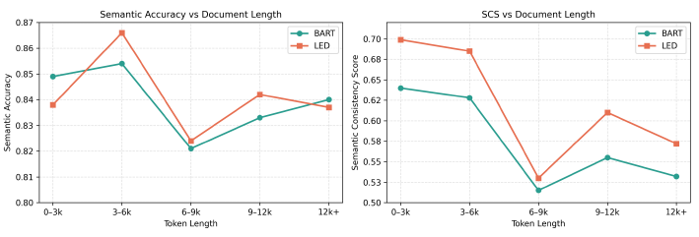
RESULTS OBTAINED
Fig. 2: Performance comparison of BART and LED models across different token lengths showing (a) semantic accuracy and (b) semantic consistency score (SCS)
The LED model performs better than BART for most document lengths, giving higher accuracy and better consistency, especially for longer documents.
Both models drop in performance for medium-length documents (6–9k tokens), but LED recovers better and handles longer documents more effectively than BART.

Slide 24
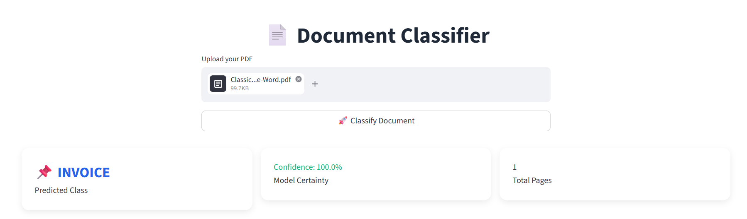
RESULTS OBTAINED
Fig.3: Document Classification Interface Showing Predicted Class and Confidence Score
The confidence score represents how certain the model is about its prediction, indicating a very high probability that the document is correctly classified as an Invoice.

Slide 25
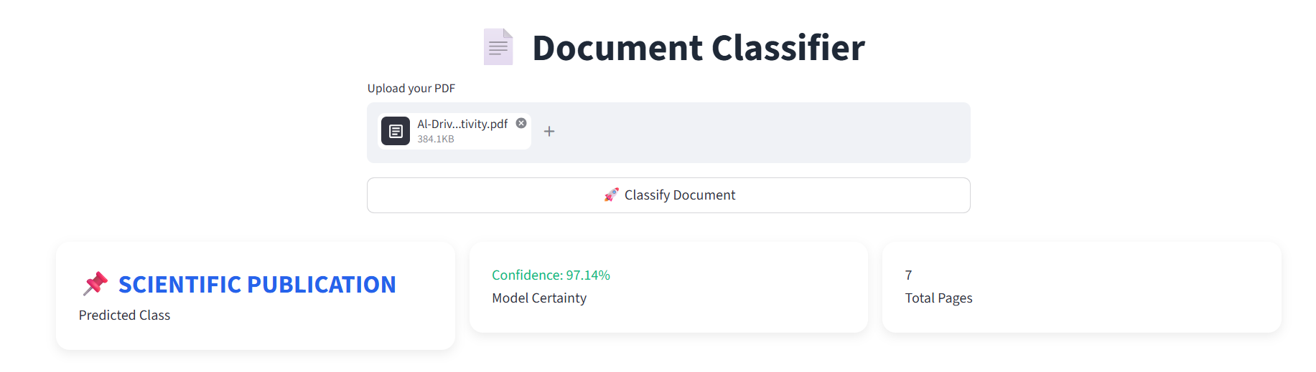

RESULTS OBTAINED
Fig.4: Document Summarization Interface

Slide 26
CONCLUSION &FUTURE WORK
CONCLUSION:
The proposed system achieves high document classification performance with ~99% accuracy and F1-scores up to 0.99, demonstrating the effectiveness of DiT in capturing layout-aware features.
The summarization module shows improved performance with LED (Semantic Accuracy: 0.8517, SCS: 0.6201) compared to BART, ensuring more coherent and informative summaries.
FUTURE WORK:
Enable real-time streaming document processing, where large documents are processed progressively and users receive partial results (classification/summary) instantly without waiting for full completion.
Integrate live document monitoring systems (e.g., emails, PDFs, enterprise data feeds) to automatically classify and summarize documents as they are generated in real time.

Slide 27
REFERENCES
[1] Sadri, A., Hossain, M.M.: Coordinate matrix machine: A human-level concept learning to classify very similar documents. arXiv preprint arXiv:2512.23749, 2025.
[2] Yan, Haolong, Kaijun Tan, Yeqing Shen, Xin Huang, Zheng Ge, Xiangyu Zhang, Si Li, and Daxin Jiang. "M-DocSum: Do LVLMs Genuinely Comprehend Interleaved Image-Text in Document Summarization?." arXiv preprint arXiv:2503.21839,2025.
[3] Qian, Kun, Wenjie Li, Tianyu Sun, Wenhong Wang, and Wenhan Luo. "DocRefine: An Intelligent Framework for Scientific Document Understanding and Content Optimization based on Multimodal Large Model Agents." arXiv preprint arXiv:2508.07021, 2025.
[4] Shankar, Shreya, Tristan Chambers, Tarak Shah, Aditya G. Parameswaran, and Eugene Wu. "Docetl: Agentic query rewriting and evaluation for complex document processing." arXiv preprint arXiv:2410.12189, 2025.
[5] Nie, Z., Arshad, M., Khurshid, S.K., Javed, A., Waheed, T., Zhang, Q., Shahzad, M.F.: Domain-specific multi-document political news summarization using bart and act-gan. IEEE Access,2025.

Slide 28
REFERENCES
[6] Chen, X., Chen, Z., Cheng, S.: Cothssum: Structured long-document summa rization via chain-of-thought reasoning and hierarchical segmentation. Journal of King Saud University-Computer and Information Sciences 37(4), 40, 2025
[7] Rani Krishna, K.M., Somasundaram, K., Arulmozhivarman, P., Immanuel, S.A., Rajkumar, E.R.: Deep learning for text summarization using nlp for automated news digest. Scientific Reports 15(1), 36343,2025.
[8] Jayatilleke, Nevidu, and Ruvan Weerasinghe. "A Hybrid Architecture with Efficient Fine Tuning for Abstractive Patent Document Summarization." In 2025 International Research Conference on Smart Computing and Systems Engineering (SCSE), pp. 1-6. IEEE, 2025.
[9] Bashir, Abubakar Salisu, Abdulkadir Abubakar Bichi, Usman Mahmud, and Abdulrahman Mohammed Bello. "Long-text abstractive summarization using transformer models: A systematic review." Journal of the Brazilian Computer Society 31, no. 1, 1263-1278,2025.
[10] Goutom, Pritom Jyoti, Nomi Baruah, and Paramananda Sonowal. "Attention-based transformer for Assamese abstractive text summarization." Procedia Computer Science 235 , 1097-1104,2024.

Slide 29
THANK YOU

